Slide 1


Smart Speak
February 2015
This document is confidential and contains proprietary information, including trade secrets of CitiusTech. Neither the document nor any of the information contained in it may be reproduced or disclosed to any unauthorized person under any circumstances without the express written permission of CitiusTech.
Notes:
http://www.istockphoto.com/photo/healthcare-and-medicine-22075110?st=3e3101d
http://www.istockphoto.com/photo/laboratory-42696182?st=3e3101d

Slide 2
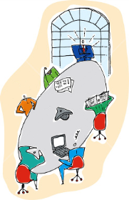
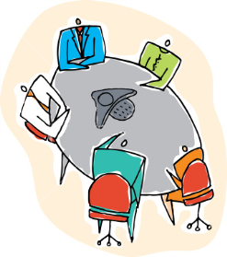
Smart Speak in a Nutshell
Current State
Desired State
Smart Speak
Smart Speak initiative will ensure that each member contributes meaningfully at least once on every call!

Slide 3
Contents
Survey Results
Client Call Examples
Recipe for Effective Calls
Extempore
Mock-a-call Debrief
Next Steps

Slide 4
Survey Results (1/5)
 | Question | A | B | C | D
Q1 | How many times do you participate in client calls? | Once a week | Twice or more | Only when needed | Never
Q2 | How do you start your meeting? | Introduce yourself | Straight to business | Exchange pleasantries
Q3 | Communication happens mostly via | Mails | Calls | Onsite person
Q4 | Do you send direct mails to client? | Yes | No

Slide 5
Survey Results (1/5)
 | Question | A | B | C | D
Q1 | How many times do you participate in client calls? | Once a week | Twice or more | Only when needed | Never
Q2 | How do you start your meeting? | Introduce yourself | Straight to business | Exchange pleasantries
Q3 | Communication happens mostly via | Mails | Calls | Onsite person
Q4 | Do you send direct mails to client? | Yes | No

Slide 6
Survey Results (2/5)
 | Question | A | B | C
Q5 | How comfortable are you talking to your clients on the calls? | Confident | Okay | Nervous
Q6 | Have you been to onsite ever? | Once | Twice or more | Never
Q7 | What have you been told by DL/TL about talking on call? | Talk Never | Speak Only when absolutely needed | No Restriction
Q8 | What according to you inhibits people? | Preparedness | Accent | Experience

Slide 7
Survey Results (2/5)
 | Question | A | B | C
Q5 | How comfortable are you talking to your clients on the calls? | Confident | Okay | Nervous
Q6 | Have you been to onsite ever? | Once | Twice or more | Never
Q7 | What have you been told by DL/TL about talking on call? | Talk Never | Speak Only when absolutely needed | No Restriction
Q8 | What according to you inhibits people? | Preparedness | Accent | Experience

Slide 8
Survey Results (3/5)
 | Question | A | B | C | D
Q9 | Are you aware of the agenda before the call | Always | Mostly | Seldom | Never
Q10 | Do you feel responsible for the calls/ work? | Only if I am asked to | Always | Never | Sometimes
Q11 | Managing CitiusTech call from two location is one of the reason for in-effective communication | Yes | No | May Be
Q12 | If I try my best to communicate but cannot effectively express myself, I should: | Settle for the way I am | Work at improving my skills | I never thought about it

Slide 9
Survey Results (3/5)
 | Question | A | B | C | D
Q9 | Are you aware of the agenda before the call | Always | Mostly | Seldom | Never
Q10 | Do you feel responsible for the calls/ work? | Only if I am asked to | Always | Never | Sometimes
Q11 | Managing CitiusTech call from two location is one of the reason for in-effective communication | Yes | No | May Be
Q12 | If I try my best to communicate but cannot effectively express myself, I should: | Settle for the way I am | Work at improving my skills | I never thought about it

Slide 10

Survey Results (4/5)
Key inhibiting factors
Inadequate preparedness – organizing thoughts prior to call, call Setup, room booking, etc.
Mode of internal team communication is not strictly English
Fear of the lead or senior team members
Lack of confidence
Difference in technical understanding
Lack of ownership
Understanding accent
General Mindset - unnecessary meetings.. finish fast
Some Comments & Suggestions
All members should get chance to interact with client at least weekly
Should have good Client sharing software for demos, calls, presentations
Guidelines for screen sharing with client
Communication skills not the root issue, knowledge, content and fearlessness is key to better communication

Slide 11
Survey Results (5/5)
Good Practices:
Everyone giving own status helps people overcome inhibitions
Back up plan for scenarios such as someone dropping off leads to avoidance of unprecedented situations
Informing team if taking call from home helps in better co-ordination
Setting agenda before each call leads to focused discussion
Moderating a call in an appropriate manner is very important
Practicing the screen sharing tool in advance helps team gain confidence
Bad Practices:
Joining call in the nick of time
Skype/Gtalk not considered by many as reliable modes for having a conference call
For taking calls from home, good communicator like Microsoft communicator or Go To Meeting should be used as it is better than Skype/Gtalk

Slide 12
Contents
Survey Results
Client Call Examples
Recipe for Effective Calls
Extempore
Mock-a-call Debrief
Next Steps

Slide 13
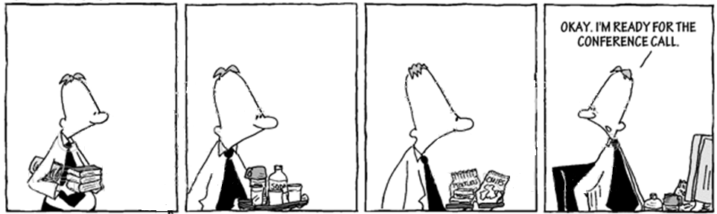
Exemplify - Client call
Example of a good client call – Audio
The above audio is a general example of a regular, good client call. You don’t have to do anything special here, just be alert, soft-spoken and courteous
Example of a bad client call – Audio1 , Audio2, Audio3
The above audio is an example of a not so good client call. You should be aware that greeting the client is necessary, you should speak when the client expects and avoid long pauses while talking etc.

Slide 14
Contents
Survey Results
Client Call Examples
Recipe for Effective Calls
Extempore
Mock-a-call Debrief
Next Steps

Slide 15
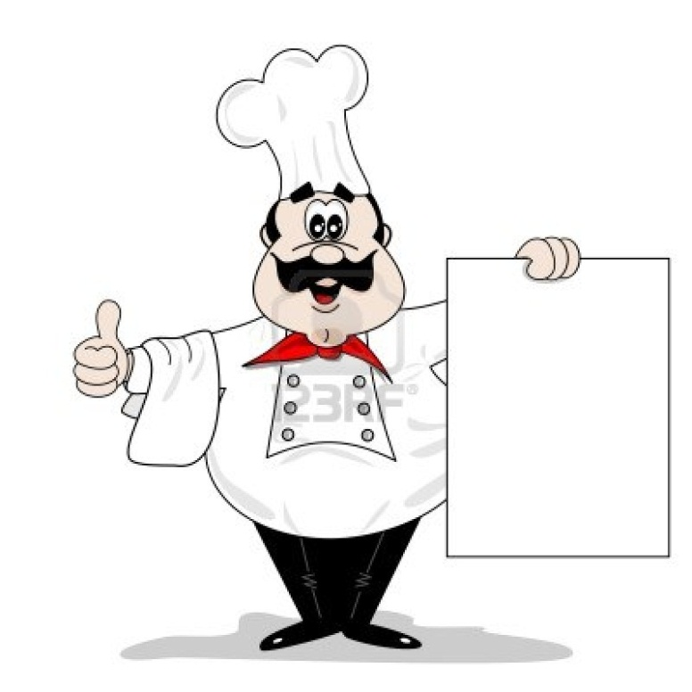
Recipe for Effective Calls (1/4)
Key aspects of a call:
Two Types of participants
Project Lead/Coordinator
Team members/ Attendees/Participants
Three phases
Pre Call
During Call
Post Call

Slide 16
Recipe for Effective Calls – Pre-call (2/4)
Project Lead/Coordinator | Team members/ Attendees/participants
Assign roles/content to team members for the call. E.g. Connecting call, taking notes/MOMs Perform a mock-up call in case of an important demo/POC Prepare team members to ask questions during the call Ensure that team members have worked on any outstanding action items from previous call Share any mails (which have been sent only to the PL, and not the entire team) with the team members, based on the sensitivity of the content. Example High-level plan of releases. | Book a meeting room for the call and prepare content to be discussed Ensure to have a copy of the document that is going to be discussed Ensure all action items from previous call, have been closed or WIP Ensure that all members have the meeting details e.g. GoToMeeting link etc. Put your phones on silent mode If your screen is shared, then close all messengers If taking call from home, then ensure a sound proof environment
Wherever appropriate, DLs & PLs, should sensitize clients about the short-comings in communication and seek their approval in letting all members of the team interact

Slide 17
Recipe for Effective Calls – During the Call (3/4)
Project Lead/Coordinator | Team members/Attendees/participants
Monitor team members during calls Handle any query from client, which team members are not able to handle on the spur of the moment Get call back on track, in case team members go off topic If you don’t understand the query posed by client, ask for clarification If query cannot be resolved right away, then assure the client that you will respond to it in an email | Be attentive even if you are not speaking Follow the lead’s instructions Be proactive and speak when you can add value to the subject of discussion Note key points discussed during call – this will be useful for the next call If you don’t understand the query posed by client, ask for clarification Talk slow, clear and loud Ensure you are close to the phone while speaking
SPEAK
YOUR
PIECE

Slide 18

Recipe for Effective Calls – Post Call (4/4)
Team Lead/ Call Coordinator | Team members/ Call Attendees/ Participants
Provide in-person feedback, in case of any areas of improvement Identify the person who will mail the MOM/action items to the client | Work on any feedback provided Work on action items assigned to self Self-assess the performance on the call Provide opinion on any issues discussed during the call
The key to a successful call is preparedness to participate– by individuals and collaboratively as a team!!!

Slide 19
Contents
Survey Results
Client Call Examples
Recipe for Effective Calls
Extempore
Mock-a-call Debrief
Next Steps

Slide 20

Extempore
Each participant has to pick a topic
Participants will get 5 minutes to think over the topic and note down points
Participants can get their notes reviewed by person sitting to their left
Each one will need to speak for 1 minute on the topic
Emphasis on following parameters
Confidence
Content
Delivery

Slide 21
Contents
Survey Results
Client Call Examples
Recipe for Effective Calls
Extempore
Mock-a-call Debrief
Next Steps

Slide 22
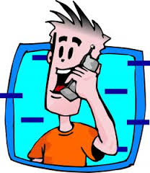
Mock-a-Call
Walk through of a call for a particular scenario
Teams need to prepare for the call, as they do for their regular clients
The process will involve all phases:
Set – up
Initiate
Actual Call
Follow-up (if any)

Slide 23
Thank You

